Slide 1
Astro 331 Lesson 16
Spacecraft Software / Fault Management
SMAD 16.1.3-16.2.1, Supp Crs Mtl

Slide 2
Lesson Objectives
Understand the terms firmware, assembly language, higher-level language and EDAC
Describe and understand the difference between the two main methods for tolerating faults
List and describe the four principal classes of software for onboard processing
Understand that flight software is embedded within each subsystem
Describe the terms fault, fault tolerance, fault mitigation, and fault protection
Understand the four areas that fault management is not suitable for addressing
Understand and describe the top three causes of spacecraft systematic faults

Slide 3
Flight Software

Slide 4
Terms
Firmware: the software which resides permanently in nonvolatile memory; reduces the susceptibility to upset, but cannot be modified after launch
Used for critical processes such as initialization or contingency operations
Often executes out of programmable read only memory (PROM)
Assembly language: contains the basic symbols and expressions used to program a specific computer
More efficient and compact than software written in higher-level language, but often takes longer to generate
Higher-level language: also has symbols and expressions, but provides more sophisticated operations and adds a level of abstraction
Examples: C, C++, Ada, etc
Preferred for maintenance, testability, and life-cycle costs
EDAC (error detection and correction): circuitry that provides tolerance of a bit error in a memory word; corrects a single-bit error in a word when it reads that word

Slide 5
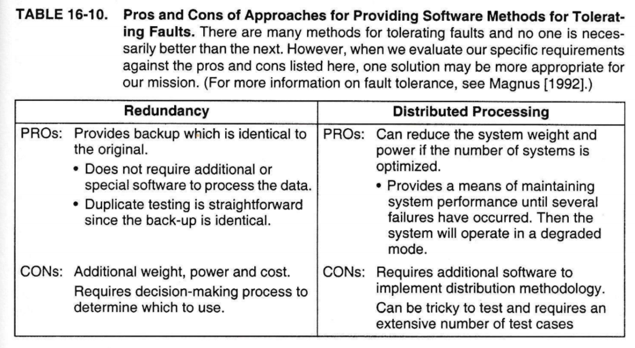
Methods for Tolerating Faults

Slide 6
Four Principal Classes of Flight Software
Control system software: software that requires and input and responds by changing the state of the system (ADCS); mathematically intensive, requires high accuracy and strict timeliness
System management software: includes such items as fault detection and correction, long duration event schedulers, and payload system management; logic intensive
Mission-data software: manipulates and compacts large quantities of data as it is collected; requires large storage capacity
Operating system software: directly manages computer resources and controls allocation of tasks
Supp Crs Mtl calls it “executive software”

Slide 7
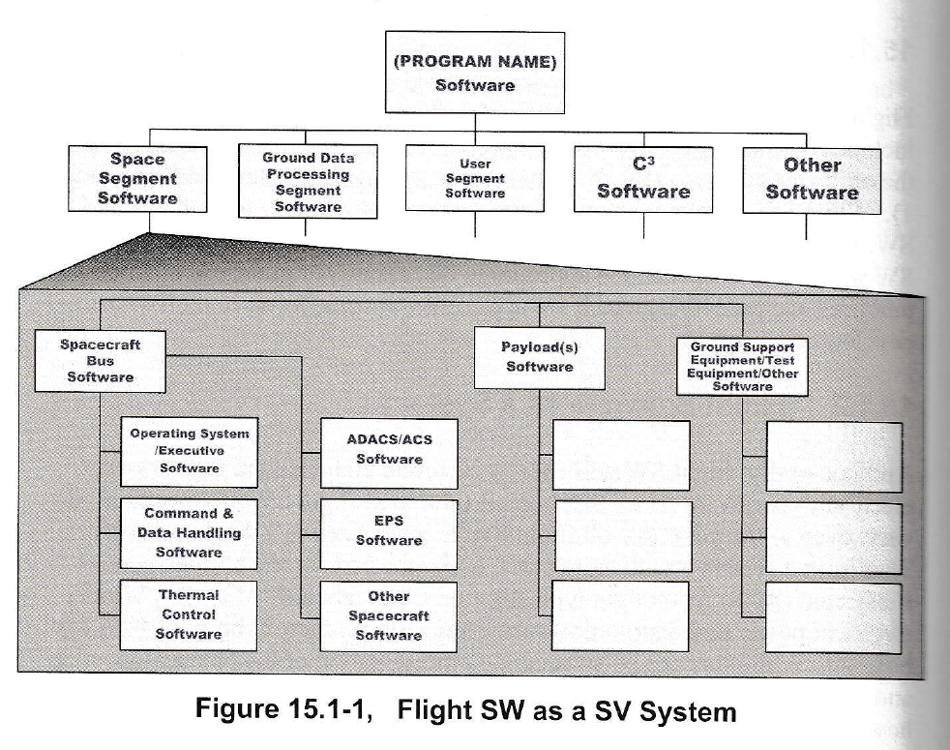
Flight Software as a System (Supp Crs Mtl)
Flight software will usually be found embedded in most subsystems
Software often physically resides in the spacecraft computer, but architectural view can be helpful to see different types of software

Slide 8
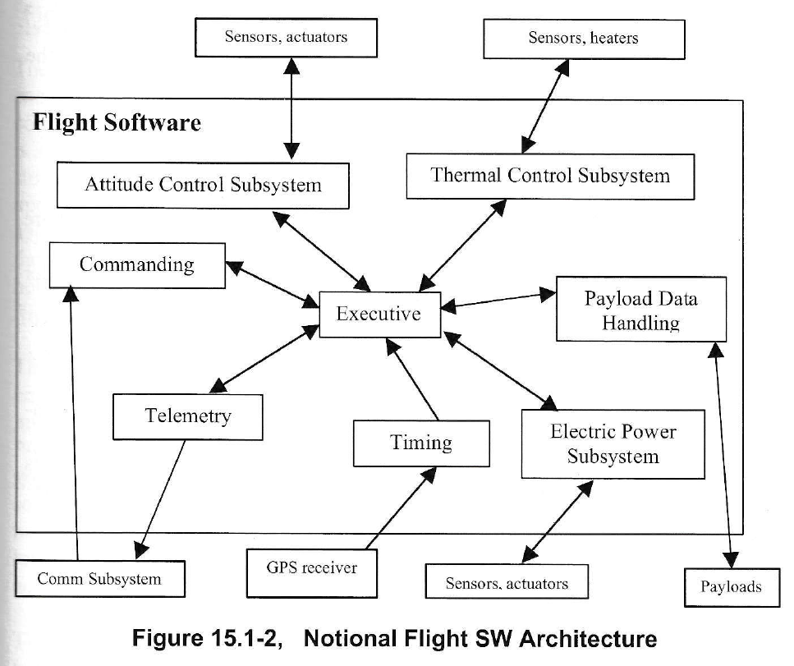

Slide 9
Commercial Flight Software vs Custom Flight Software
“Custom” flight software is developed specifically for the mission
Commercial (COTS) flight software has been used for other missions
Regardless of the source of the SW, keep in mind that it is “new” SW in the sense that it’s new for the current mission and must be developed/integrated properly and thoroughly tested

Slide 10
Fault Management

Slide 11
Terms Definitions
Fault: an unexpected response whereby the function is recoverable, either by fixing it, managing around it, or by redundancy
Fault tolerance: the number of faults that the system must tolerate to meet its specifications
Fault mitigation: the passive mitigation of faults through design
Examples: ARM/EXECUTE command pairs for hazardous commands, extra solar array strings
Fault protection: the implementation of design intended to actively control the effects of a fault
Limited to detecting and responding to discrete defects which may arise in the operation of an otherwise healthy space vehicle
Intended to detect faults (or the effect of a fault) and intervene so that the fault does not permanently affect the safety of the space vehicle
Fault management: an engineering discipline that addresses the occurrence of faults on the space vehicle and provides a means for reducing their effect through cooperative design of both the space vehicle and ground elements and operator actions; includes fault tolerance, fault mitigation and fault protection

Slide 12
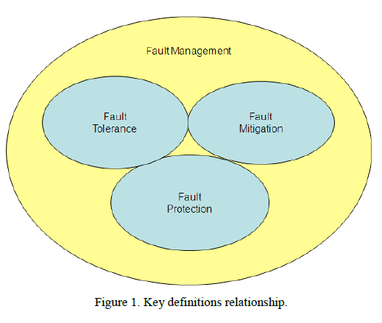

Slide 13
Four areas that fault management is NOT suitable for addressing
Defects in space vehicle unit design
Eg: reaction wheel bearing failure due to being incorrectly sized, software coding error
Prevention of design errors must be addressed by a thorough analysis, design review and validation program
Defects in the space vehicle or unit architecture
Fault protection relies on a redundant function being available in the event that the primary has been impacted by a fault
Defects in the space vehicle assembly, either design or manufacturing related
Eg: reaction wheel being installed with incorrect polarity
These errors should be addressed by a thorough ground test program
Common cause defects
Where a process, practice or material results in a component that is deficient
Eg: part is overstressed during ground tests due to procedure and thus all parts are impacted and redundancy is no longer helpful

Slide 14
Causes of Spacecraft Failures
All space vehicles are subject to the hazards of their environment, handling practices, hardware and software failures as well as threats from adversaries (link denial).
Understanding why and how satellites fail allows for selection of appropriate mitigation efforts, including architectural design choices and appropriate fault management techniques in order to maximize the chance of space vehicle survival.
Faults may occur in any component of the space vehicle, or in the connections or interfaces between system components. These faults fall into two main categories:
1) Random hardware faults, assumed to occur with a constant random failure rate.
2) Common mode faults (including specification, design errors, improper parts and materials for the space environment, and workmanship errors).

Slide 15
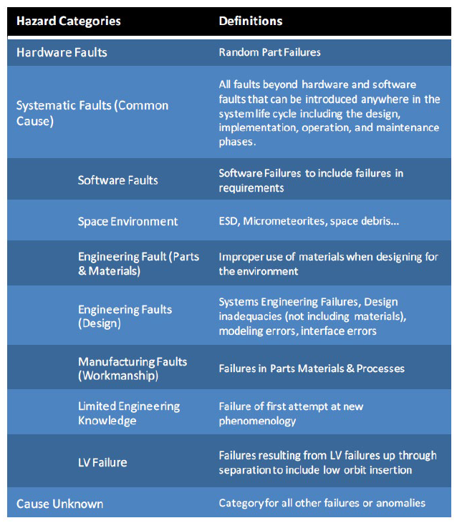

Slide 16

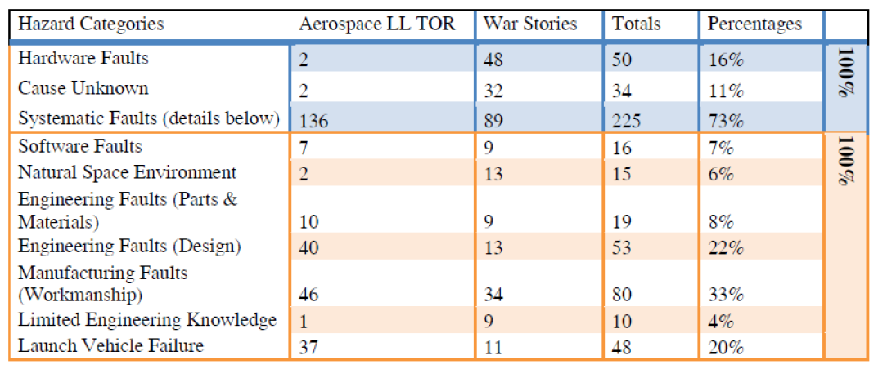

Slide 17
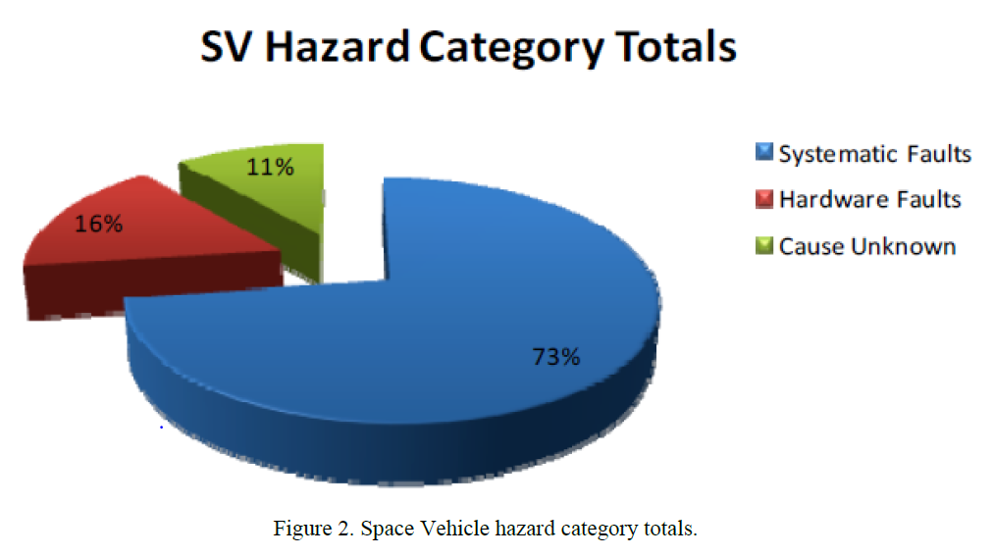

Slide 18
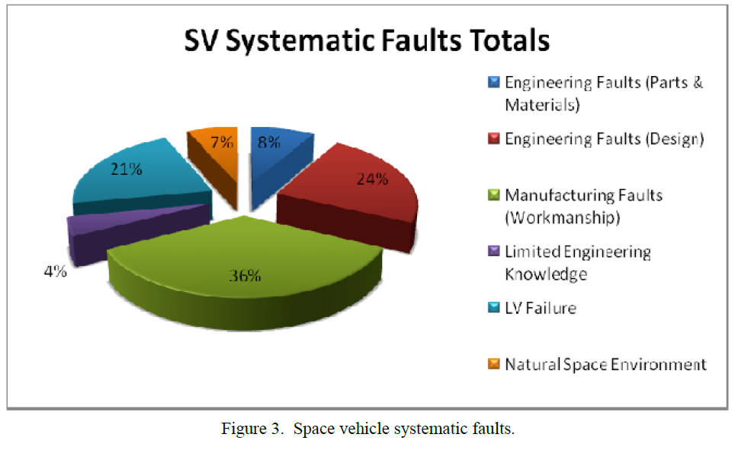

Slide 19
So what?
So, what are the main causes of Systematic Faults in spacecraft failures?
1. Manufacturing Faults (Workmanship): 36%
2. Engineering Faults (Design): 24%
3. Launch Vehicle Failure: 21%
4. Engineering Faults (Parts & Materials): 8%
5. Natural Space Environment: 7%
6. Limited Engineering Knowledge: 4%
The space vehicle hazard analysis shows that most space vehicle failures are due to common cause, or systematic faults rather than random hardware faults. To maximize the chance of space vehicle survival, fault management systems should encompass both robust space vehicle design, as well as a fault management system.
Conclusion: There should be a focused effort on preventing common cause failure mechanisms. Analysis of the space vehicle failure data reveals that 60% of the failures are due to systematic faults relating to design errors (and it could be argued that the space environment failures could be considered design faults), component, and workmanship issues that fault management systems are not intended to address. To ensure mission success, it is imperative that the space vehicle be designed and built to withstand the effects of the space environment.

